Slide 1


In the Name of God
Chapter 1
Language function: Nouns in a nutshell

Slide 2



concrete
abstract
Common nouns
countable
uncountable
collective
compound
Proper nouns

Slide 3
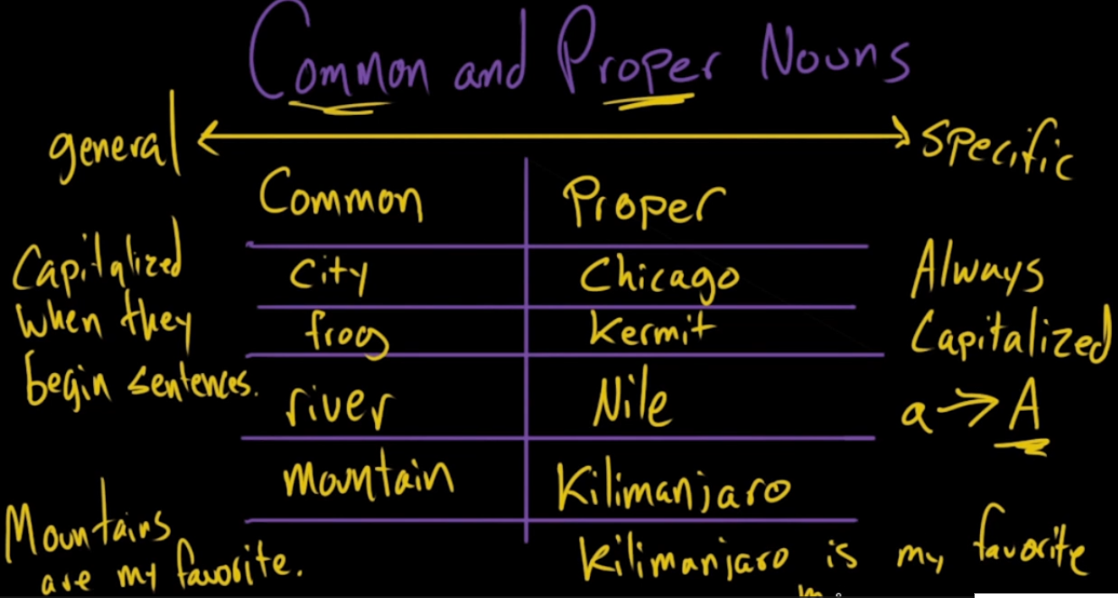
https://www.khanacademy.org/humanities/grammar/parts-of-speech-the-noun/types-of-nouns/v/common-and-proper-nouns

Slide 4


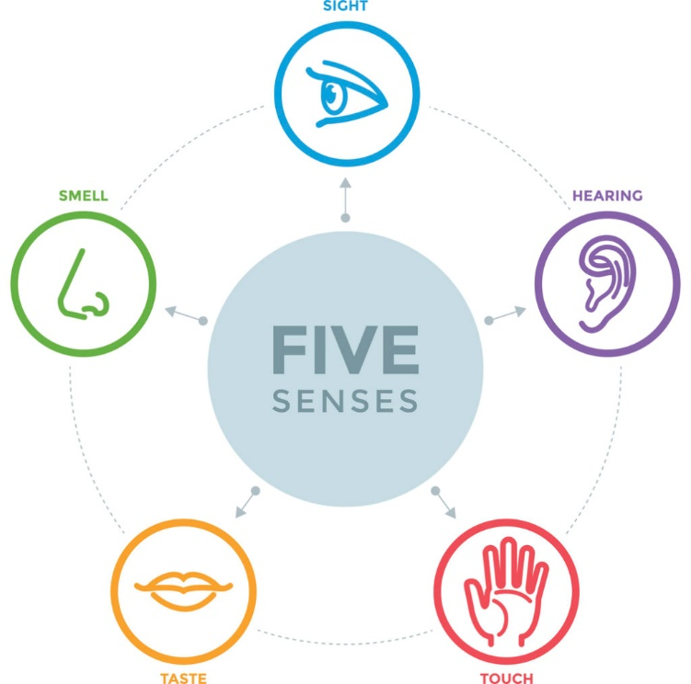
The things, places, and people that you can see, touch, hear, smell, and taste are called concrete nouns.
Person
engineer
teacher
researcher
The principal
moderator
university
Place
airport
Shiraz
Spain
gym
book
laptop
Thing
locomotive
spoon
shelf

Slide 5
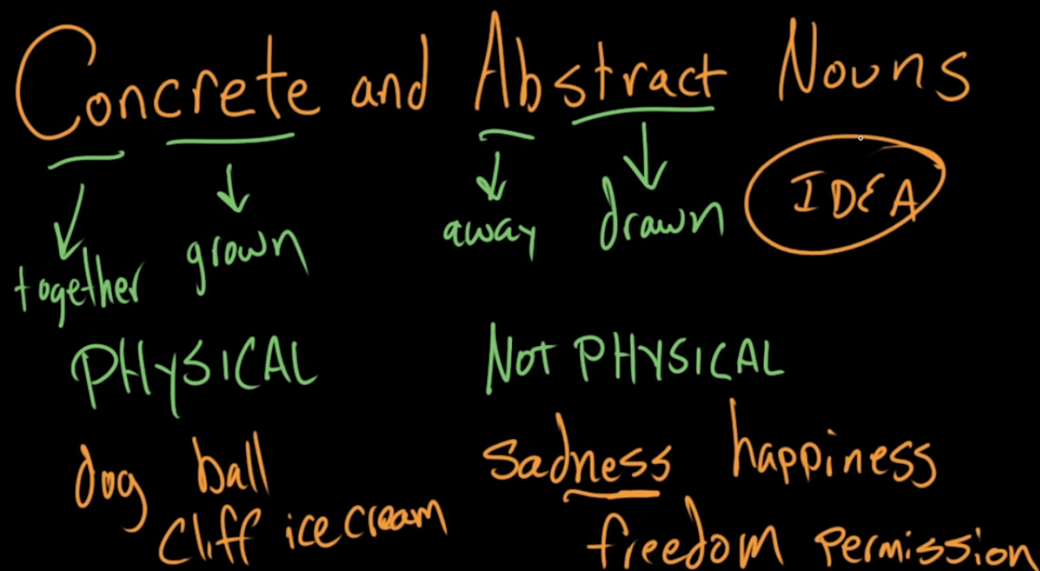
https://www.khanacademy.org/humanities/grammar/parts-of-speech-the-noun/types-of-nouns/v/concrete-and-abstract-nouns

Slide 6

The emotions and ideas/concepts that cannot be seen, touched, heard, smelled, or tasted with your five senses are called abstract nouns:
Idea Emotion
Religion Happiness
Time Surprise
Creativity Grief
Motivation Excitement

Slide 7

Proper nouns: Common/concrete nouns referring to a specific or unique name
The initial letter is capitalized:
I am flying first-class on Iran Air.
Takht-e Jamshid is a world heritage site located in Fars.
Mohammad, Ali, and Sahand study Engineering at Amirkabir University.
LinkedIn is an online platform for professional networking.
Siamak Ansari always uses the online services provided by Baya.

Slide 8


Compound nouns
Nouns made up of two or more words that refer to one thing, place, person, or idea :
Noun + Noun: bedroom, firefly, sea food, bus stop, mineral water
Adjective + Noun/gerund: software, blackboard, greenhouse, dry-cleaning
Noun + Verb: sunrise, haircut, rainfall
Verb/gerund + Noun: breakfast, washing machine, swimming pool, driving license
Verb + preposition: check-out, check-up
Coronavirus
COVID-19

Slide 9
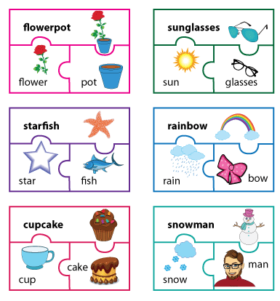
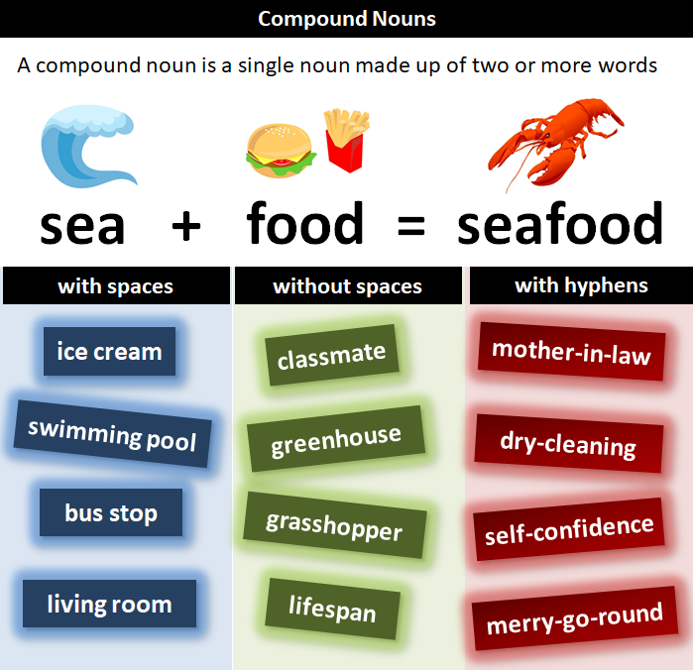

Slide 10

Collective nouns
People
Class Army Navy
Group Team Board
Faculty Council Committee
Audience Family Staff
Company Crowd Crew
A collection/group of people/animals/things:
Animals/things
Flock
Pack
Forest
Library
Album

Slide 11
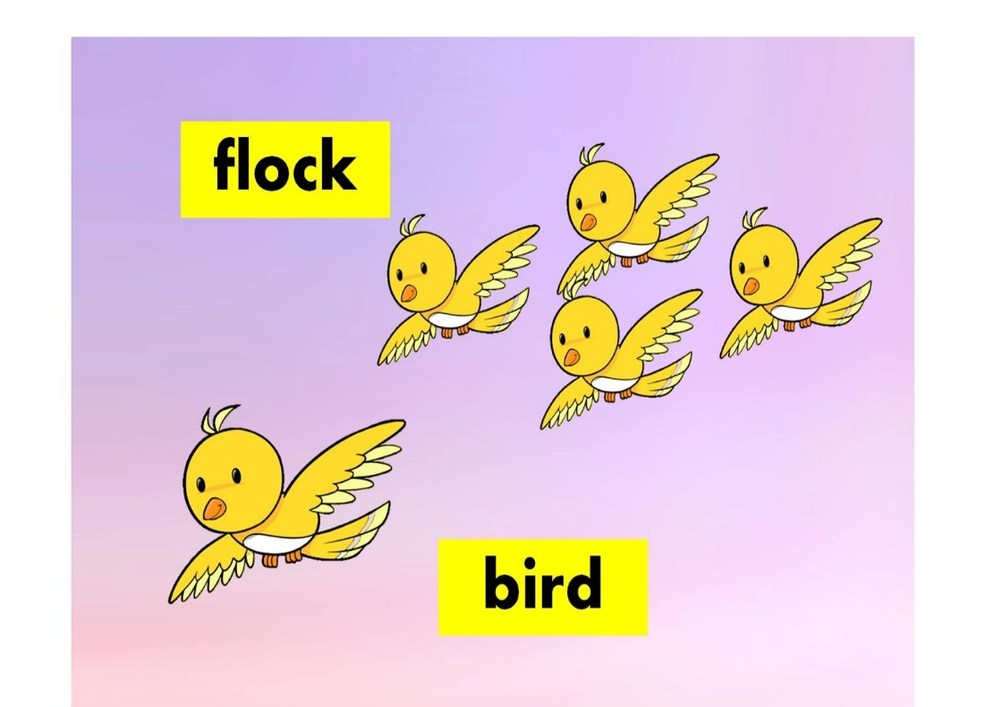
Our class took a trip to the National Museum.
The town council approved the proposed plan.
The robotics team aims to win the international contest.
The board is meeting on Wednesday.
Saravan forest is a tourist attraction in Gilan.
Note: subject-verb agreement:
If the collective noun refers to the group as a unit, then it takes a singular verb. If it refers to the individuals in the group, the verb should be plural.
The team is heading for practice this afternoon.
The team are eating with their families tonight.

Slide 12

Gerunds
Nouns that are formed by adding an –ing to a verb root are called gerunds.
Note: A verb or a gerund phrase?
Our top priority was getting everyone on the plane.
The critical issue of his arrest wasn’t driving without a license.
A good career for her might be coaching soccer.
My biggest difficulty is sleeping through the night.
The difference between a gerund and an –ing verb is that gerunds do not have tobe (am, is, are, was, and were, be, been) immediately before them while –ing verbs have:
Gerund: Skiing has been her passion since she was 5 years old.
-ing verb: She is skiing in the snow-covered mountains.
https://www.gingersoftware.com/content/grammar-rules/gerund-phrase/

Slide 13

Gerund: Coding is developers’ favorite hobby.
Verb + ing: Hosein and Ashkan have been coding JavaScript for two years.
Gerund: Faezeh and Hanieh enjoy learning.
Verb + ing: Faezeh and Hanieh are learning C ++ language.

Slide 14

Gerund phrases
Gerunds that are followed by other words like objects and modifiers are called gerund phrase:
Gerund: Speaking is one of the main four language skills.
Gerund phrase: Speaking English fluently and with correct accent is the goal of many language learners.
Gerund phrases: Other examples
We would not recommend travelling without insurance.
Why don’t you make completing a marathon your main goal?
My biggest difficulty is sleeping through the night.
By crying like a baby, you won’t get anywhere in life.
Exercise is futile without eating healthily.
https://www.gingersoftware.com/content/grammar-rules/gerund-phrase/

Slide 15

Countable nouns:
can be counted and take –s plural
Courses
Children
Engines
Singular verb form for uncountable nouns:
Further information about this device is provided in the manual.
It is the intelligence of her writing that impresses me.
Uncountable nouns:
cannot be counted and do not take –s plural
Information
Intelligence
Equipment
advice

Slide 16
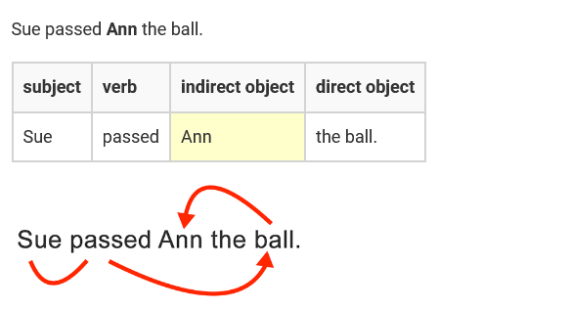
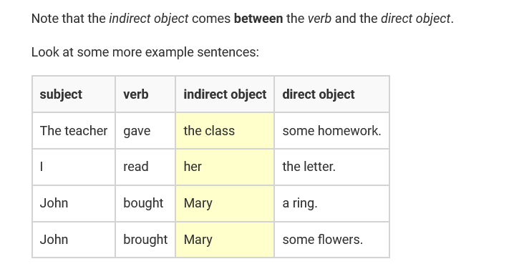
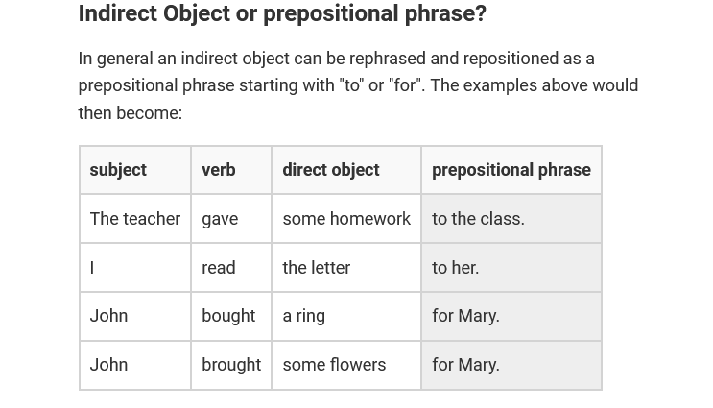
https://www.englishclub.com/grammar/sentence/indirect-object.htm

Slide 17
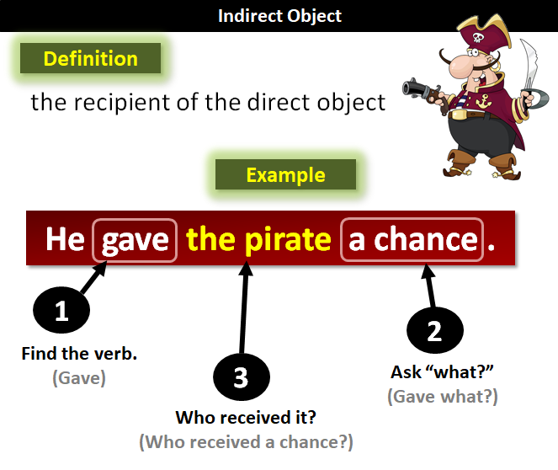

The indirect object of a verb receives the direct object.
Shall I tell the children our ghost story tonight?
I have given the room a quick inspection.
Parsa and Nima gave their professors the proposals.
Helia bought her sister a present.
https://www.grammar-monster.com/glossary/indirect_object.htm

Slide 18
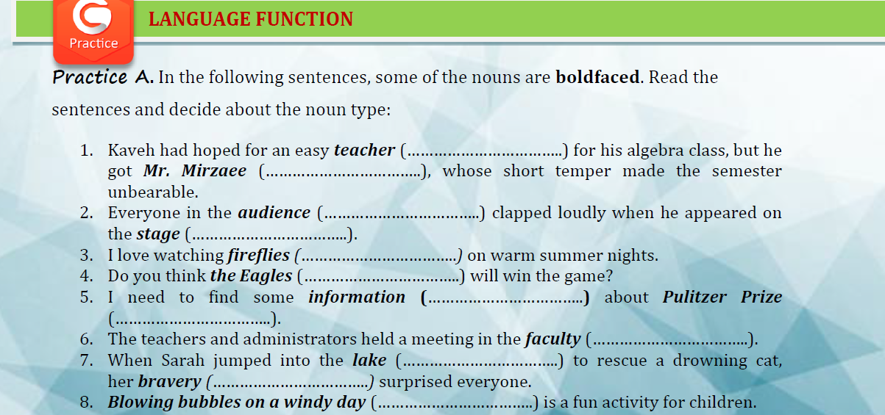

Slide 19
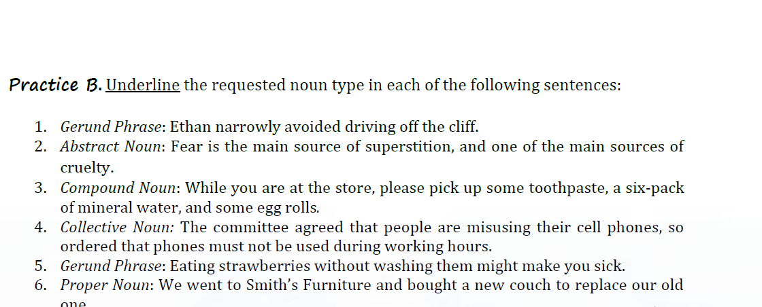

Slide 20
Noun construction
Suffixes | Examples
-ship | friendship, membership, scholarship, fellowship, leadership, citizenship
-ment | sediment, movement, involvement, entertainment, disagreement, refreshment
-tion, -sion | production, connection, education, direction, communication mission, collision, decision, confusion, explosion
-ity, -ty | necessity, activity, complexity, equality, publicity, validity cruelty, certainty, loyalty, specialty, casualty, modesty
-ness | readiness, usefulness, weakness, forgiveness, cost-effectiveness, willingness

Slide 21
Suffixes | Examples
-al -ial | arrival, removal, disposal, proposal, refusal, approval burial, trial, denial
-ance -ence | reliance, performance, assistance, guidance, endurance, insurance defence, reference, difference, preference, existence, correspondence
-acy, | accuracy, bureaucracy, privacy, primacy, legitimacy
-ate | candidate, graduate, certificate
-ant, -ent | assistant, immigrant, observant, applicant, defendant component, recipient, resident, solvent

Slide 22
Suffixes | Examples
-ary/ery/ory | sedimentary, itinerary, solitary memory, accessory, laboratory fishery, bakery, bravery
-ancy/ency | redundancy, expectancy, vibrancy efficiency, consistency, dependency
-age | baggage, postage, package, marriage
-ic/tic | characteristic, critic, attic, topic
-dom | boredom, freedom, kingdom

Slide 23

Suffixes | Examples
-er/or/ar (agent) | user, conveyor, cylinder, builder, interpreter, advertiser, advisor, supervisor, actor, director, instructor, navigator
-ee | employee, trainee, refugee, attendee
-hood | childhood, neighborhood, brotherhood, neighborhood
-ism | socialism, tourism, imperialism, favoritism, conservatism
-th | depth, growth, length, birth, wealth

Slide 24

Suffixes | Examples
-tude | altitude, magnitude, amplitude
-ing | building, feeling, meeting, seating, landing
-ist (person) | socialist, analyst, typist, novelist, cartoonist, journalist
-ice | notice, practice
-ics | ethics, physics, plastics, statistics, mathematics
-y | history, economy, beauty

Slide 25
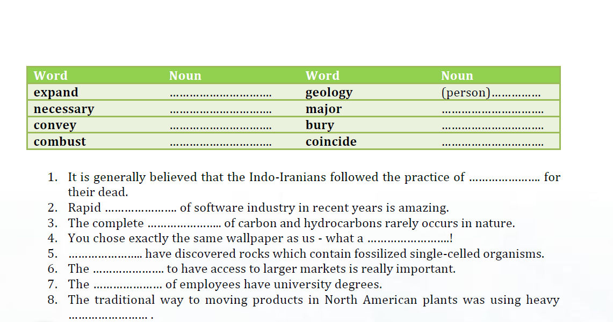

Slide 26

Topic sentence: main idea
Writing Essentials
Supporting sentences: Specific details
Concluding sentence: wrap-up

Slide 27


